Slide 1

Non digital time
Digital time
Time line
History of computing
by
Francisco David Martín Reguero
1º DAM
First Generation
Second Generation
Third Generation
Fourth Generation
Fifth Generation

Slide 2
Non digital time
Digital time
Time line
First Generation
Second Generation
Third Generation
Fourth Generation
Fifth Generation

Slide 3
Non digital time
Digital time
Time line
First Generation
Second Generation
Third Generation
Fourth Generation
Fifth Generation

Slide 4
Non digital time
Digital time
Time line
First Generation
Second Generation
Third Generation
Fourth Generation
Fifth Generation

Slide 5
Non digital time
Digital time
Time line
First Generation
Second Generation
Third Generation
Fourth Generation
Fifth Generation

Slide 6
Non digital time
Digital time
Time line
First Generation
Second Generation
Third Generation
Fourth Generation
Fifth Generation

Slide 7
Non digital time
Digital time
Time line
First Generation
Second Generation
Third Generation
Fourth Generation
Fifth Generation

Slide 8
Non digital time
Digital time
Time line
First Generation
Second Generation
Third Generation
Fourth Generation
Fifth Generation

Slide 9
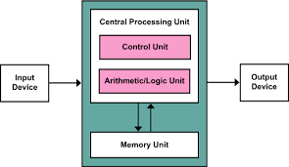
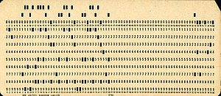
DIGITAL TIME
In the digital era, the Atanasoff Berry computer was the first electronic digital computer. The von Neumann architecture was proposed by John von Neumann, who introduced the concept of storing instructions and data in a single memory, which improved the efficiency of computers. Alan Turing also made important contributions to theoretical computer science and artificial computation.
Non digital time
Digital time
Time line
First Generation
Second Generation
Third Generation
Fourth Generation
Fifth Generation
NON DIGITAL TIME
Before the advent of digital computers, people used various computing devices, such as the abacus and the ruler. Charles Babbage and Ada Lovelace made important advances in the design of computing machines, while Herman Hollerith developed punched cards for data processing. Godfrey Leibniz and George Boole laid the foundations of modern computing with their work on binary arithmetic and Boolean algebra.

Slide 10
Non digital time
NON DIGITAL TIME
DIGITAL TIME
Digital time
Before the advent of digital computers, people used various computing devices, such as the abacus and the ruler. Charles Babbage and Ada Lovelace made important advances in the design of computing machines, while Herman Hollerith developed punched cards for data processing. Godfrey Leibniz and George Boole laid the foundations of modern computing with their work on binary arithmetic and Boolean algebra.
In the digital era, the Atanasoff Berry computer was the first electronic digital computer. The von Neumann architecture was proposed by John von Neumann, who introduced the concept of storing instructions and data in a single memory, which improved the efficiency of computers. Alan Turing also made important contributions to theoretical computer science and artificial computation.
Time line
First Generation
Second Generation
Third Generation
Fourth Generation
Fifth Generation

Slide 11
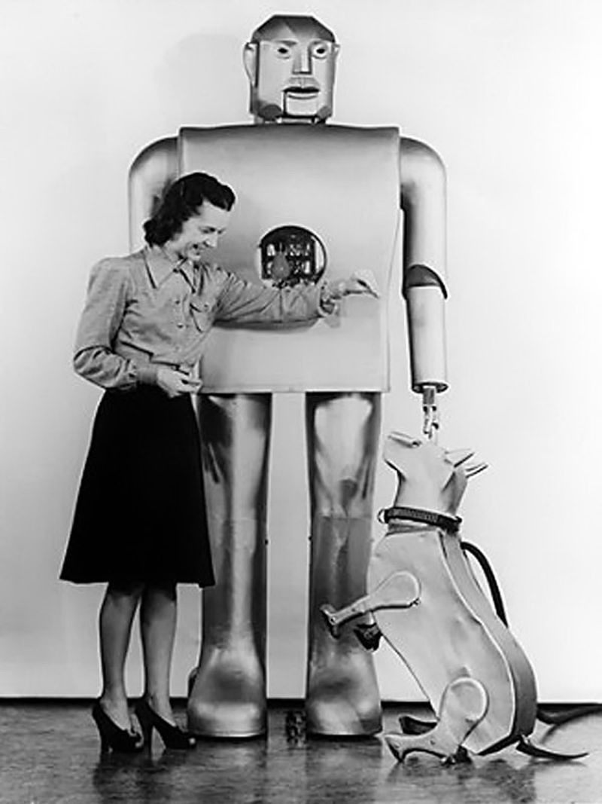
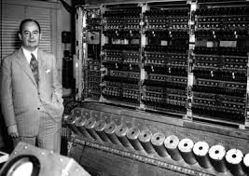
1938-1959
1966-1971
1981- Actual
1960-1965
1972-1981

Slide 12
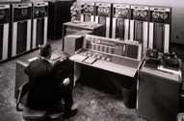
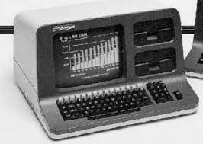
1938 - 1959
The first generation of computers marked a before and after in the history of computing.
Despite their limitations, these computers paved the way for future advances.
The development of the Atanasoff Berry computer and the Von Neumann architecture laid the foundation for the next generations of computers.

Slide 13
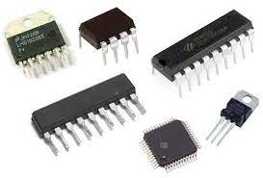
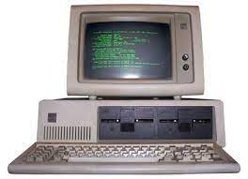
1960 - 1965
The use of transistors, integrated circuits and magnetic memories resulted in smaller, faster and more reliable computers.
These machines played a pivotal role in a variety of industries and laid the foundation for future advances.
The legacy of second-generation computers can still be seen today in the powerful and compact devices that have become an integral part of our daily lives.

Slide 14
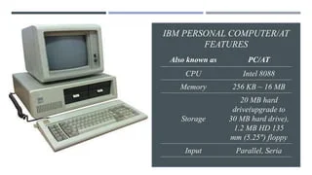
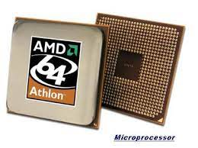
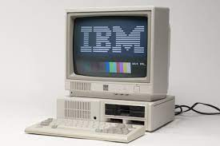
1966 - 1971
The third generation of computers marked an important event in the history of computing.
With the introduction of transistors, these machines were faster, more reliable and more versatile than their predecessors.
The standardized architecture, operating systems and high-level programming languages introduced during this era laid the foundation for modern computer technology.
Third-generation computers, such as IBM System/360, revolutionized computing and scientific computing and paved the way for further advances in the field.
These advances have shaped the world we live in today, where technology plays a vital role in all aspects of our lives.
1972-1981
The advent of microprocessors, multitasking capabilities, high-level programming languages and the personal computer revolutionized the way we interact with technology. These advances laid the groundwork for other innovations and paved the way for the modern computer technology we depend on today.

Slide 15
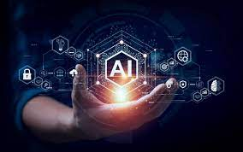
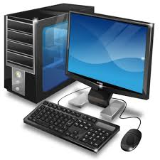
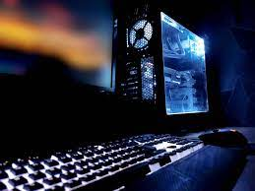
1981-Actual
FGCS (Fifth Generation Computer Systems)
It was an ambitious project that Japan initiated in the late 1980s with the aim of developing a new type of computer that would use artificial intelligence methods and techniques at both the hardware and software levels. Today, the computer industry is focused on improving and optimizing computers for users, making them more comfortable to use and realistically addressing people's needs.
In conclusion The FGCS project has had a major impact on computer technology, in particular on hardware, programming languages, operating systems, artificial intelligence and databases, paving the way for the development of modern computing.
1972-1981
The advent of microprocessors, multitasking capabilities, high-level programming languages and the personal computer revolutionized the way we interact with technology. These advances laid the groundwork for other innovations and paved the way for the modern computer technology we depend on today.

Slide 16
1981-Actual
FGCS (Fifth Generation Computer Systems)
It was an ambitious project that Japan initiated in the late 1980s with the aim of developing a new type of computer that would use artificial intelligence methods and techniques at both the hardware and software levels. Today, the computer industry is focused on improving and optimizing computers for users, making them more comfortable to use and realistically addressing people's needs.
In conclusion The FGCS project has had a major impact on computer technology, in particular on hardware, programming languages, operating systems, artificial intelligence and databases, paving the way for the development of modern computing.
1972-1981
The advent of microprocessors, multitasking capabilities, high-level programming languages and the personal computer revolutionized the way we interact with technology. These advances laid the groundwork for other innovations and paved the way for the modern computer technology we depend on today.

Slide 17
1981-Actual
FGCS (Fifth Generation Computer Systems)
It was an ambitious project that Japan initiated in the late 1980s with the aim of developing a new type of computer that would use artificial intelligence methods and techniques at both the hardware and software levels. Today, the computer industry is focused on improving and optimizing computers for users, making them more comfortable to use and realistically addressing people's needs.
In conclusion The FGCS project has had a major impact on computer technology, in particular on hardware, programming languages, operating systems, artificial intelligence and databases, paving the way for the development of modern computing.
FIN

